Slide 1
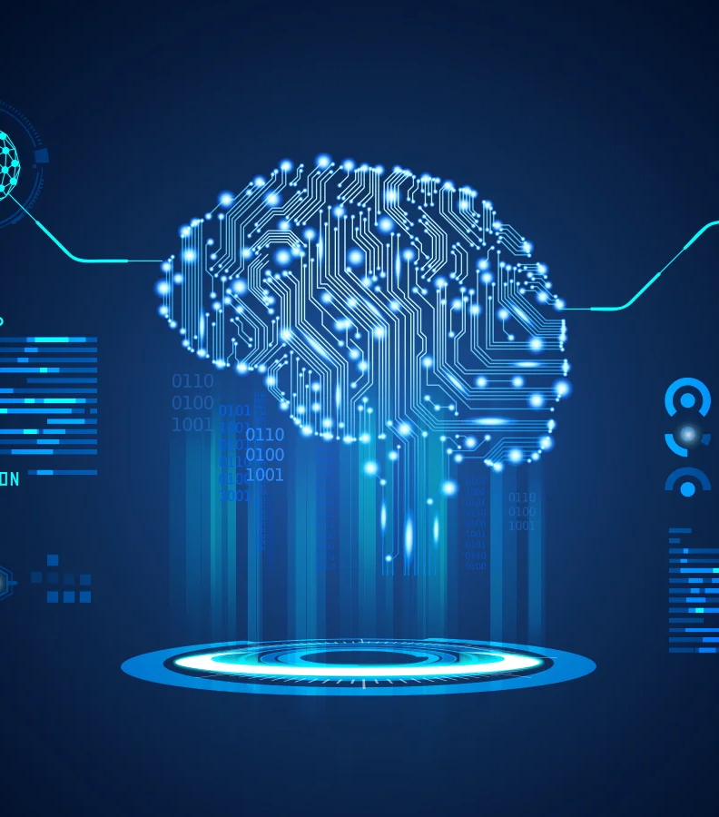
TEXT TO IMAGE CONVERTER
Name:
Aastha Prakash:500101844
Aditi Mupalla: 500105986

Slide 2
INTRODUCTION
A text-to-image converter is an advanced tool powered by artificial intelligence (AI) that transforms written descriptions into visual images.
This technology leverages deep learning models, enabling the system to interpret the text and generate corresponding visual representations, which closely align with the provided description.

Slide 3
Aim of the Project
The aim of this project is to develop a robust and efficient text-to-image converter that generates high-quality, realistic, and contextually accurate images based on textual descriptions.
This system seeks to bridge the gap between language understanding and visual generation by leveraging advanced deep learning techniques, such as natural language processing (NLP) and generative adversarial networks (GANs), to interpret and render text prompts into visually coherent images.
The ultimate goal is to enhance creative processes, support content generation, and offer novel applications in areas such as graphic design, advertising, and digital art.

Slide 4
Objectives
Build a Text-to-Image Pipeline: Create an automated system capable of interpreting text prompts and generating corresponding images using the Stable Diffusion model.
Enable Customizability: Allow users to fine-tune parameters such as image resolution, adherence to prompts, and processing steps for greater control over the output.
Ensure Reproducibility: Use fixed random seeds to produce consistent outputs for the same inputs, an essential feature for debugging and iterative design.
Explore Computational Efficiency: Optimize the system for resource usage by leveraging GPU capabilities and memory-efficient configurations.

Slide 5
Stable Diffusion 3.5
Stable Diffusion is a latent text-to-image diffusion model capable of generating photo-realistic images given any text input
These models are highly customizable for their size, run on consumer hardware, and are free for both commercial and non-commercial use under the permissive Stability AI Community License.

Slide 6
Technical Overview
Key Technologies Used:
Diffusion Models: For generating images from noise,
guided by text prompts.
Transformers: GPT-2 for optional prompt generation.
Frameworks:
diffusers for Stable Diffusion.
transformers for GPT-based prompt handling.
torch for computations on CPU/GPU.

Slide 7
THANK YOU!!

